Slide 1

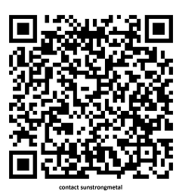
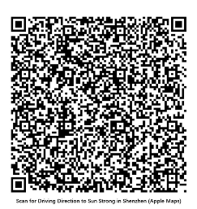

Forming a Productive Partnership
Keeping customers satisfied and relaxed
20260530ST

Slide 2
Quick Facts
Background
Founded in 1979
Headquarters: Hong Kong
3 Factories: Shenzhen, Huizhou, Chonburi
Specialized in sheet metal stamping, fabrication, welding, assembly, powder coating, tooling, and fixtures
Flexibility
Batch Size: High Volume and LVHM
Wide part size and dimension capability
Quality and GHG Management
IATF-16949 certified by BSI
ISO-14064-1 certified by BSI
ERP/EDI
Epicor
Other Highlights
REV 0 participation
40+ years of experience
550+ staff
150+ press stations
300+ robotic arms
2000+ PNs PPAP approved
60-1500 ton pressing capacity
Onsite ROHS testing
Deliveries, 60% NA, 30% EU, 5% AP and China, 5% Others

Slide 3
International Customers
Industrial Systems: Zebra, BDT, BUFAB, Diebold, Bosch, Applied Material, Rafi, Netzsch, Barco
Data and Cloud: BDT
Commercial Vehicles: Bendix CVS, Sensata, Knorr Bremse, Aperia, RH Sheppard
Home Appliances: Haier, GE Appliances, Electrolux, Fisher Paykel
Energy and Environment: Danfoss, ABB, Parker Hannifin, Sanyo Denki, SMA,
Sunpower, BHGE
Entertainment: Meyer Sound, RCF, QSC, Genelec
Gaming: IGT, Brightstar, Everi, Konami, Bright
Food Processing: FBD
Infant Product: Stokke
Global EMS: GPV, Jabil, Foxconn, Venture, Trio

Slide 4
Quality Assurance, Product Safety
Major In-house Test Equipment
• Rupture Intensity Testing Machine
• Compression Strength Tester
• Micro Vickers Hardness Tester
• Tensile Testing Machine (Pull Force)
• Spark Optical Emission Spectrometer
• Color Assessment Cabinet
• Gloss Meter
• Salt Spray Test Chamber
• Thermal Cycle Test Chamber
• Delta E Colorimeter
• XRF Coating Thickness Measurement
• Progressive Video Capturing
• ROHS Compliance Analyzer
• Lamination Adhersion Analyzer
• Bridge-type Coordinate Measuring Machine

Slide 5

Quality Assurance, Product Safety

Slide 6
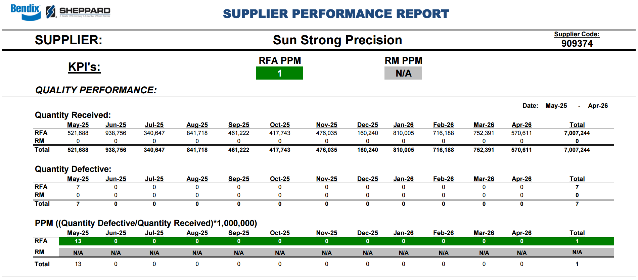
Quality Assurance, Product Safety

Slide 7
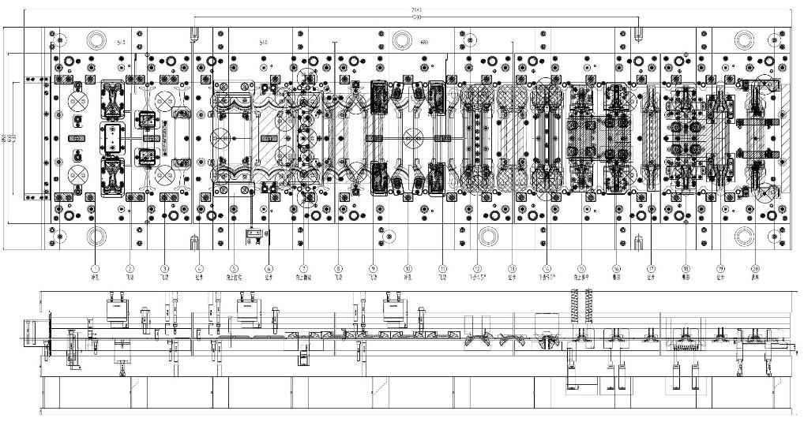
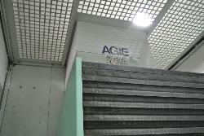
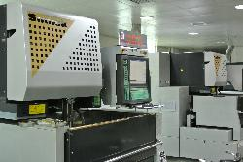
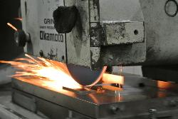
Engineering, Tooling and Fixture
Sun Strong offers complete in‑house tooling capabilities, from concept and CAD modeling to full production tooling and long-term maintenance

Slide 8
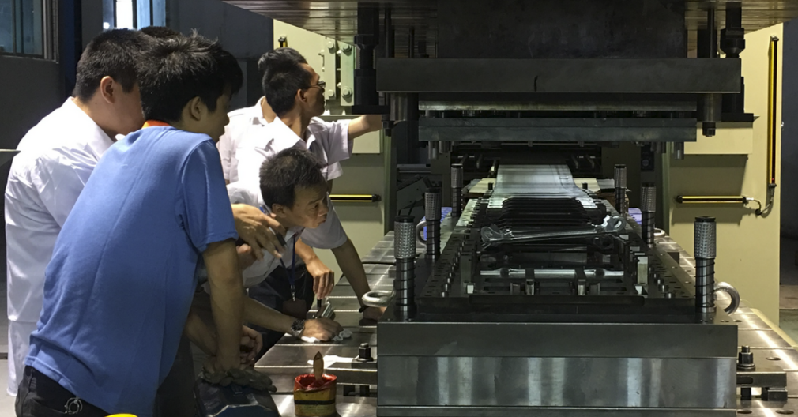
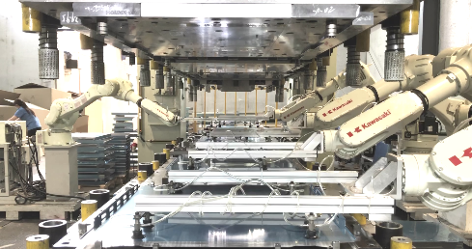
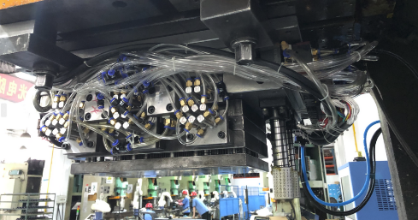
Engineering, Tooling and Fixture
Sun Strong delivers tooling that elevates manufacturing performance, repeatability, and consistency

Slide 9
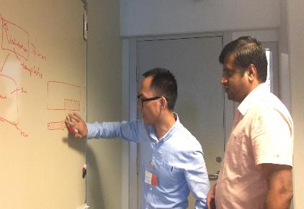
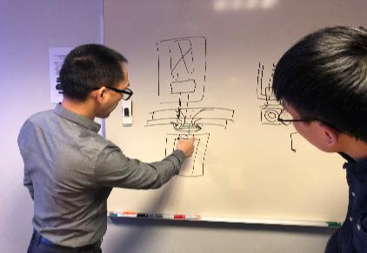
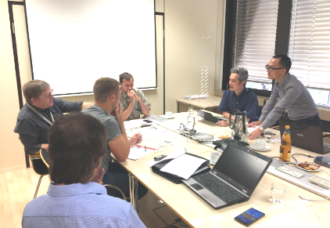
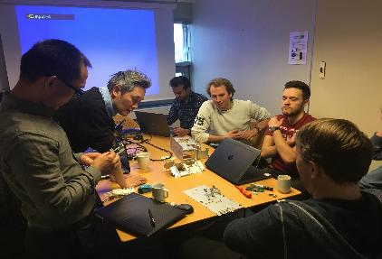
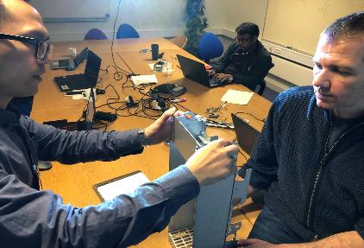
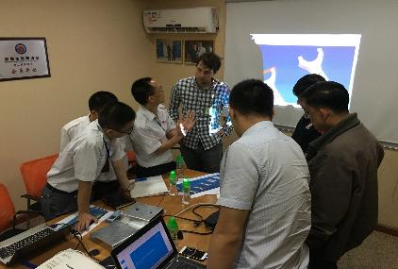
Engineering, Revision 0 Participation
Our engineers provide full technical support from concept and offer early strategic input at Revision 0, to reduce redesign and shorten development

Slide 10
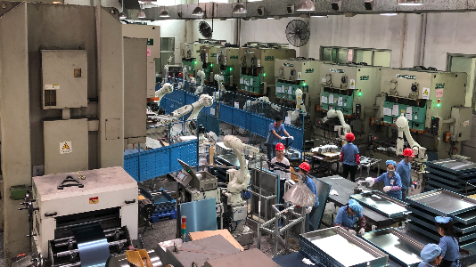
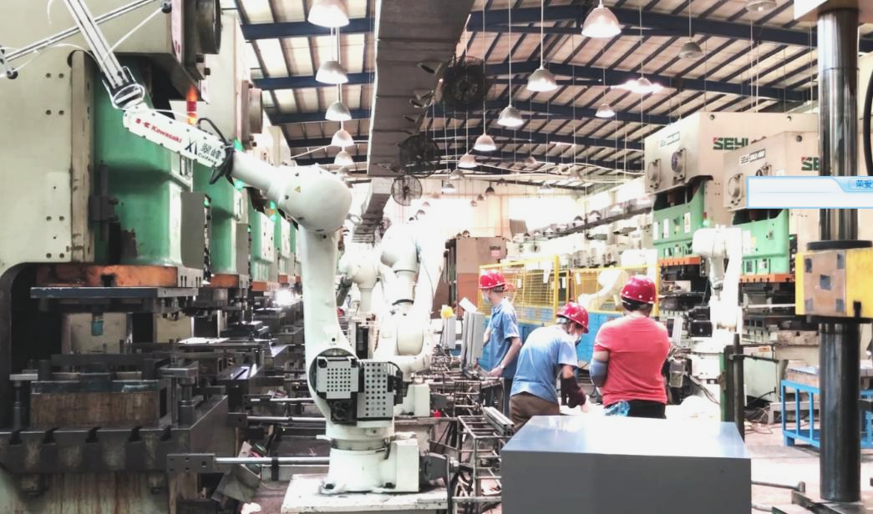
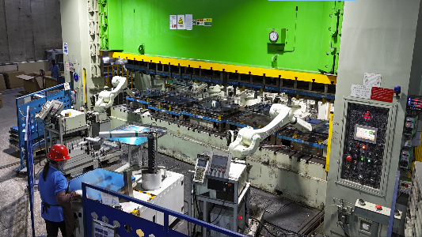
Production, HV
Robotic pick and place/feeding systems are setup across workshops to enhance efficiency and safety

Slide 11
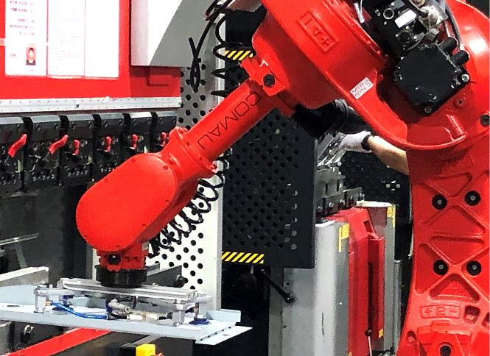
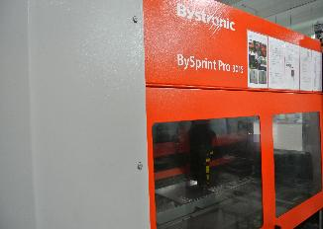
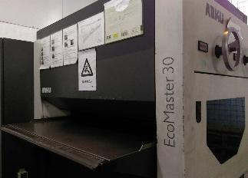
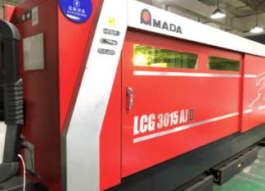
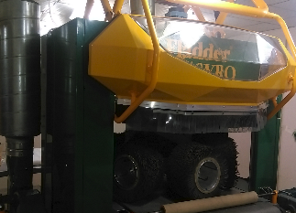
Production, LVHM
In addition to cutting, punching and bending, Leveling and Deburring systems are also “critical equipment” to support LVHM production. We can also design special-purpose tooling to ensure repeatability and consistency on critical features

Slide 12
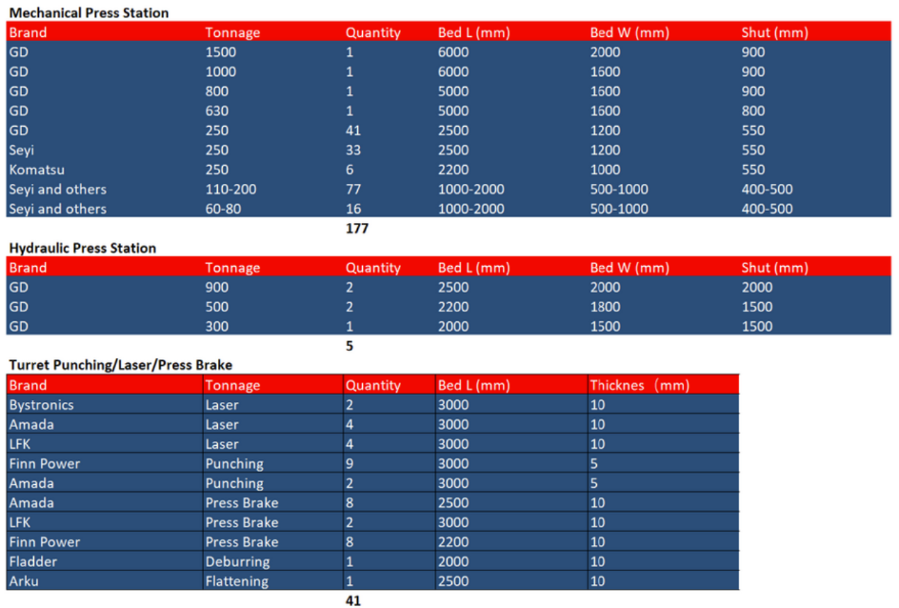
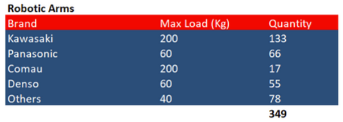
Production, Major Equipment

Slide 13
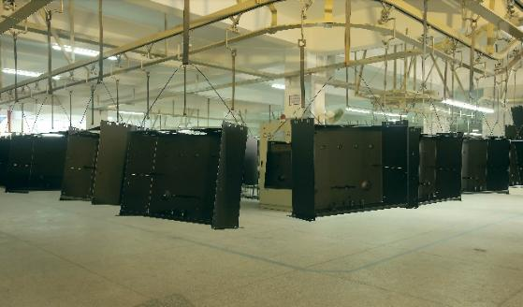
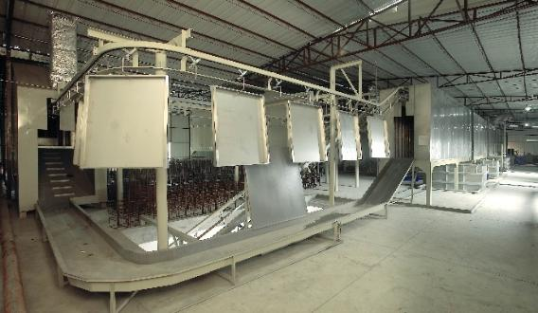
Powder Coating
Sun Strong delivers high performance powder coating solutions for industries including outdoor infrastructure, energy, commercial vehicles, electronics and food processing

Slide 14
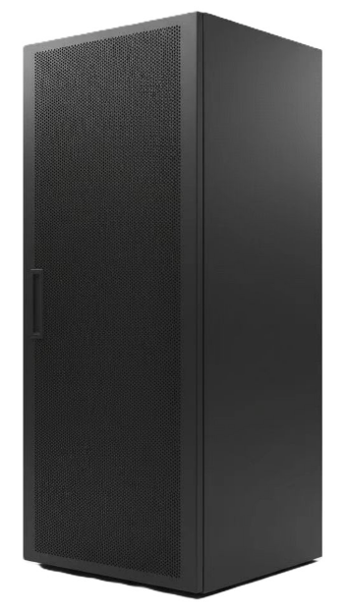
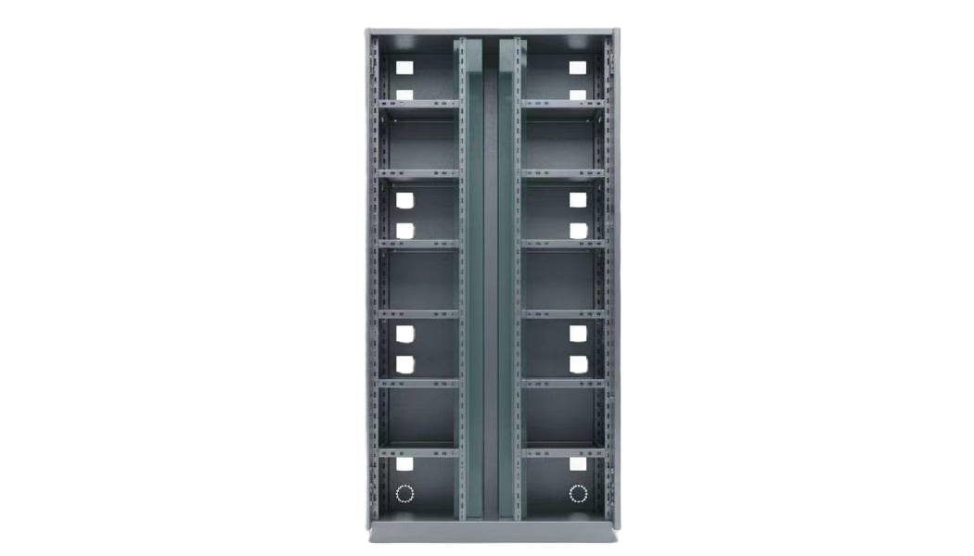
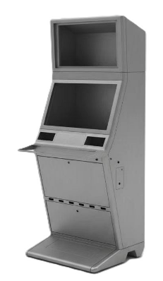
Large Parts and Assembly
Sheet Metal Cabinets for
Ticket Kiosks
Data Storage 48U
Vending Machines

Slide 15
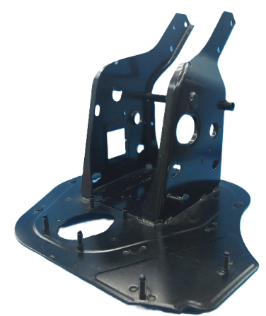
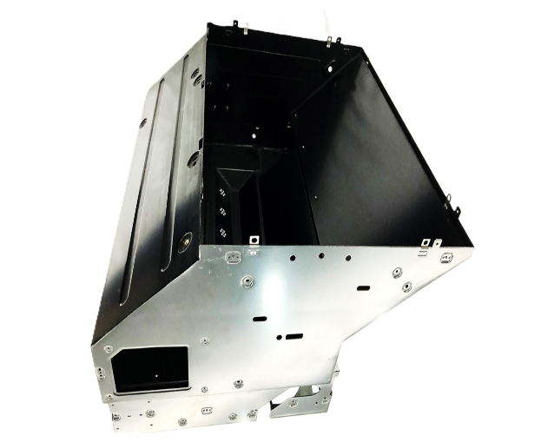
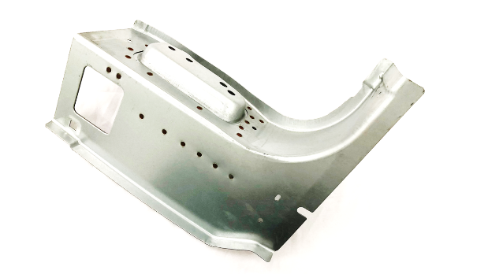
Small Parts and Assembly
Sheet Metal Assembly/Weldment for
Commercial Vehicles

Slide 16
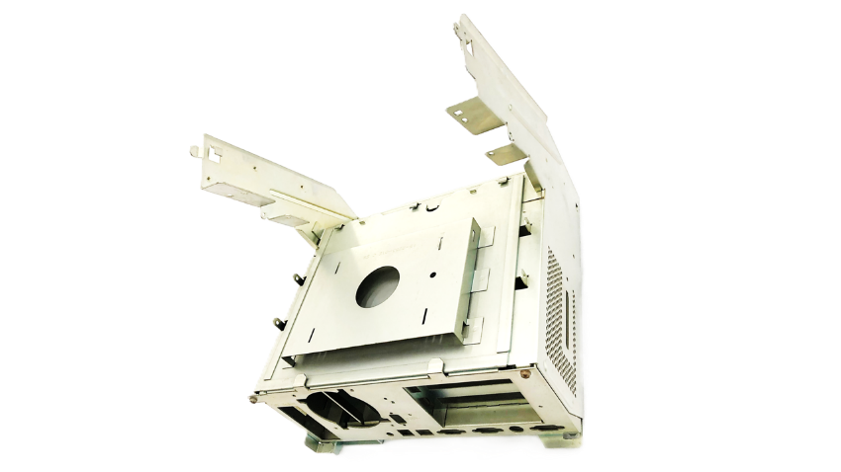
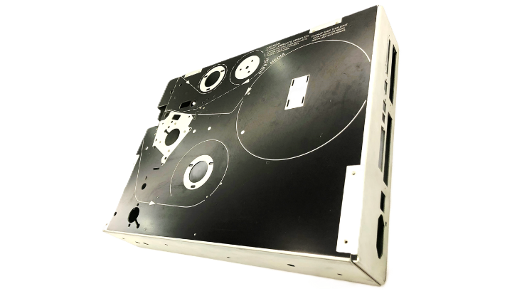
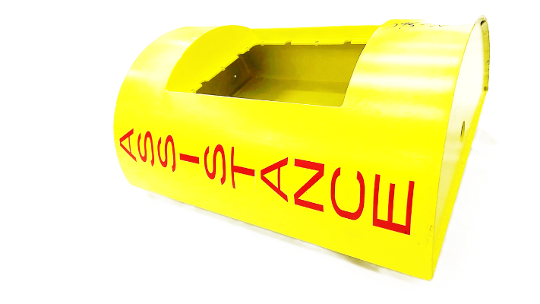
Small Parts and Assembly
Sheet Metal Assembly/Weldment for
Industrial Applications
Lottery Terminals
Emergency Systems

Slide 17
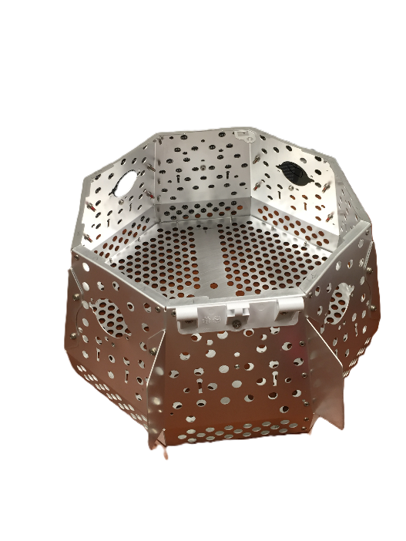
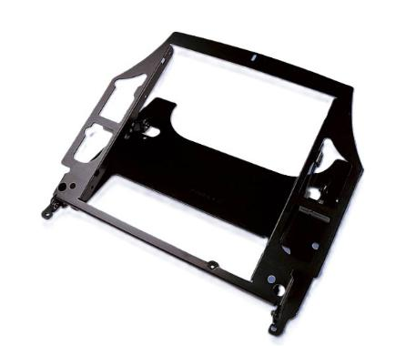
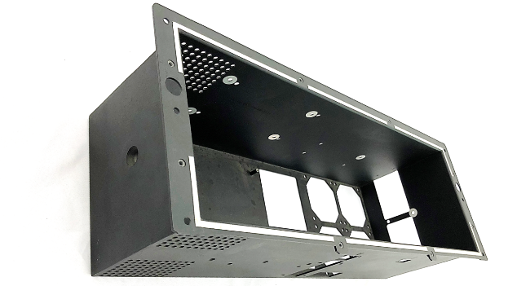
Small Parts and Assembly
Sheet Metal Assembly/Weldment for
Industrial Applications
Satellite Communication

Slide 18
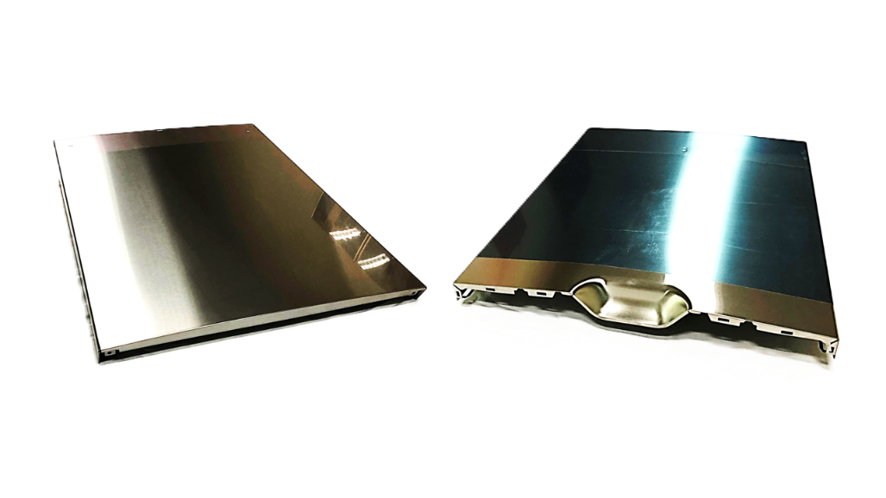
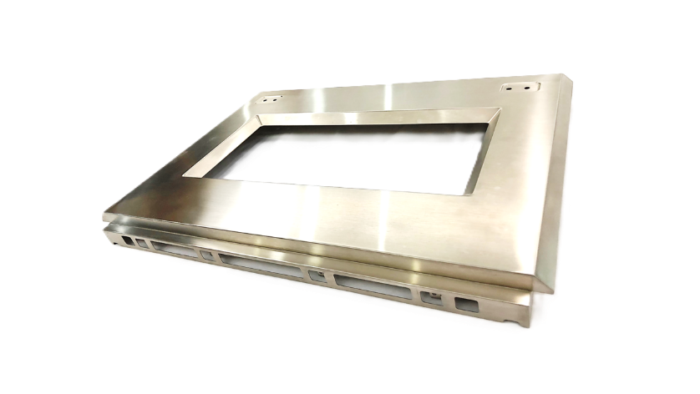
Small Parts and Assembly
Sheet Metal Assembly/Weldment for
Home Appliances

Slide 19
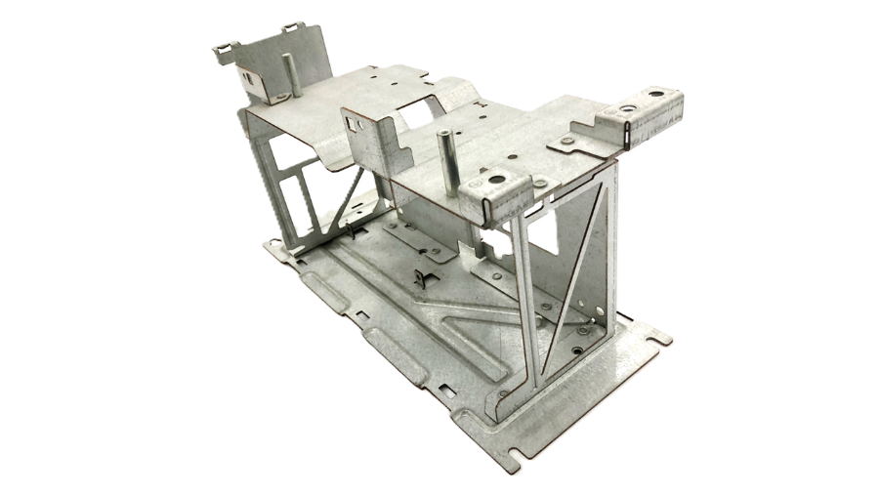
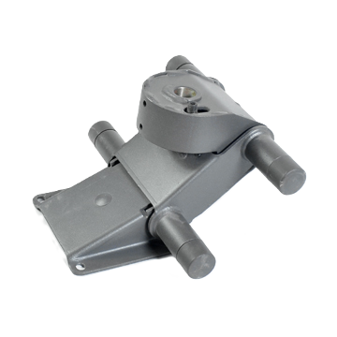
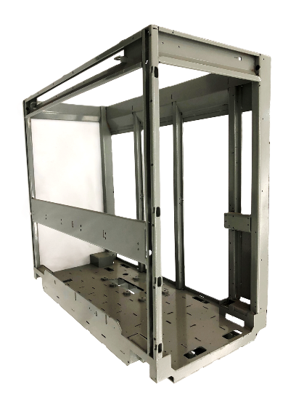
Small Parts and Assembly
Sheet Metal Assembly/Weldment for
Industrial Applications

Slide 20
Short and Long Term Plans
2026: Expedite and enhance production capabilities of Chonburi facility
2027: Increase pressing capability to 3000T
Expand mechanical assembly capability
Expand machining capability
2028: Enter home appliances market
Invest in a new facility in Czech Republic
2030: Invest in a new facility in Mexico

Slide 21
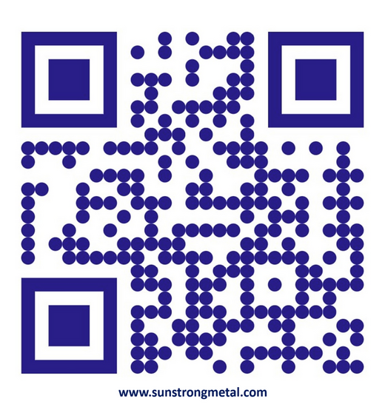
Please visit our site for more information and updates,
Thank you for the opportunity!
sunstrongmetal.com,
sunflymetal.com,
​sunstrong.ai
​are domains owned and managed by
​Sun Strong Precision Metal International Ltd.

Slide 22
